Slide 1
Classification of Genuine Impressions in AdSense by Calculating User Dwell Time
Project Guide Batch Members
Ms.T.Aruna Anisha Kumari K(316136410003)
K. Roop Hima Vaishnavi(316136410049)
B. Krishnaveni (316136410013)
B. Bhavana (316136410006)

Slide 2
Abstract
Nowadays, advertisements are publicized through webpages and the webpage owners charge their clients for each click/impression.
Recent studies show that half of the impressions are in fact not viewed by users.
In this case, although advertisers are charged for the impressions, their marketing message is not received by users.
This project implements a model to predict the genuinity of an impression made by the users when they click an ad, by considering the page depth and the time spent by the user to read that page.
In this project, we design a model to predict the genuineness of an impression made by the users when they click an ad by considering the page depth and the time spent by the user to read that page.

Slide 3
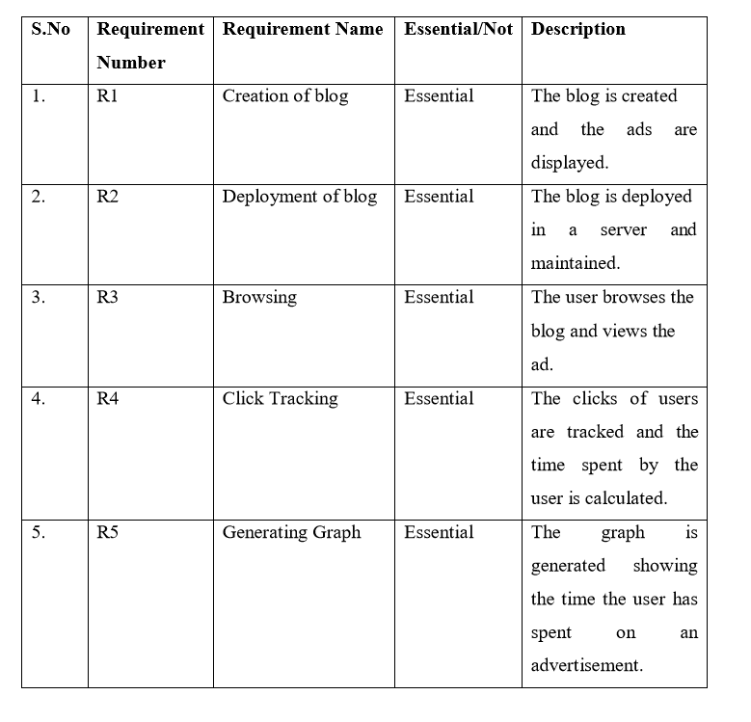
Software Requirement Specifications

Slide 4
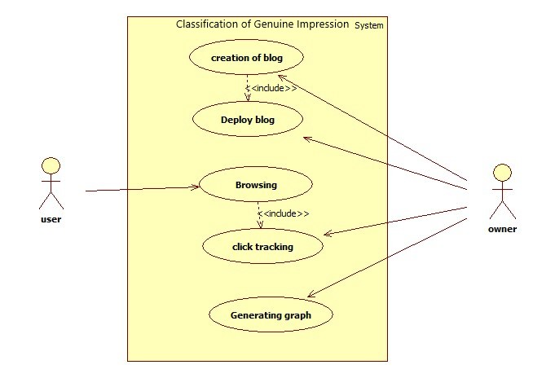
Use Case Diagram

Slide 5
Procedure
The blog is created and the advertisements are added to the blog. The blog is then deployed in a distributed server.
Google Tag Manager and Google Analytics are linked to the blog.
In Google Tag Manager, Tags, Triggers and Variables are created and using these, we tracked the user clicks and calculated the dwell time.
The dwell time is displayed as a graph, using Google Analytics.
Based on a threshold time that we fixed as per the depth of the webpage of the ad, we compare the user dwell time with the threshold time and differentiate the clicks as genuine or accidental.

Slide 6
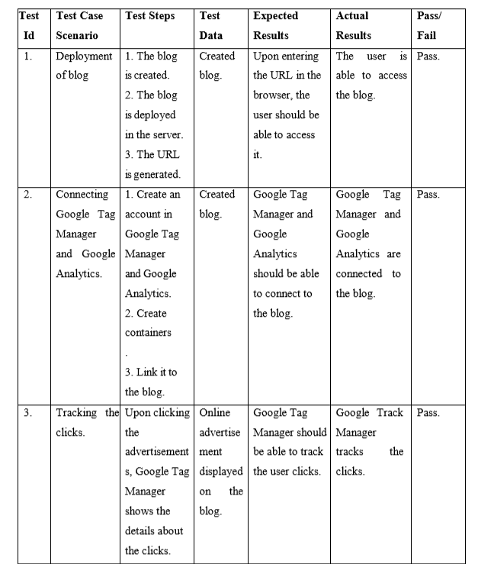
Test Cases

Slide 7
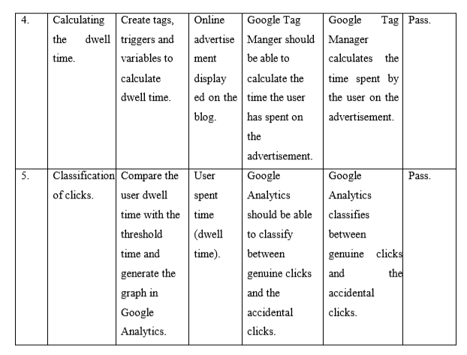

Slide 8
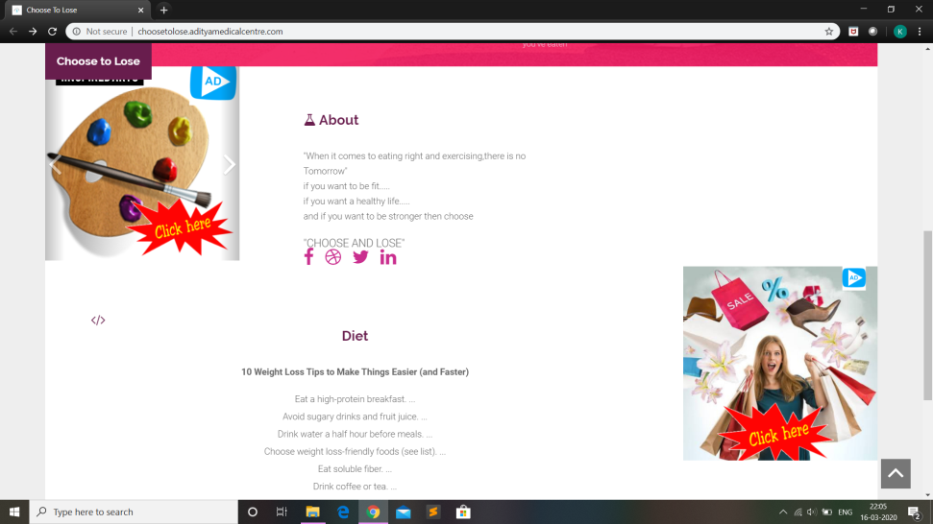


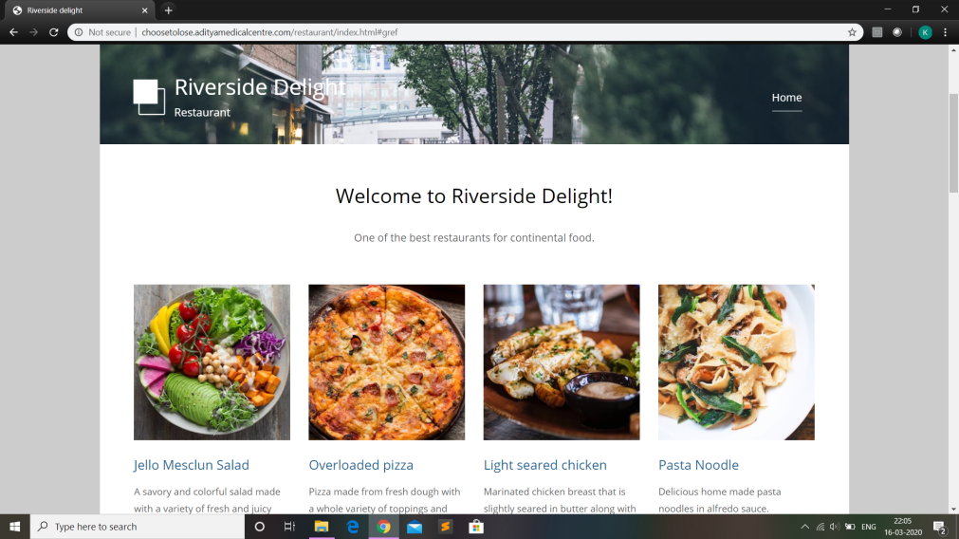
Output Screens

Slide 9
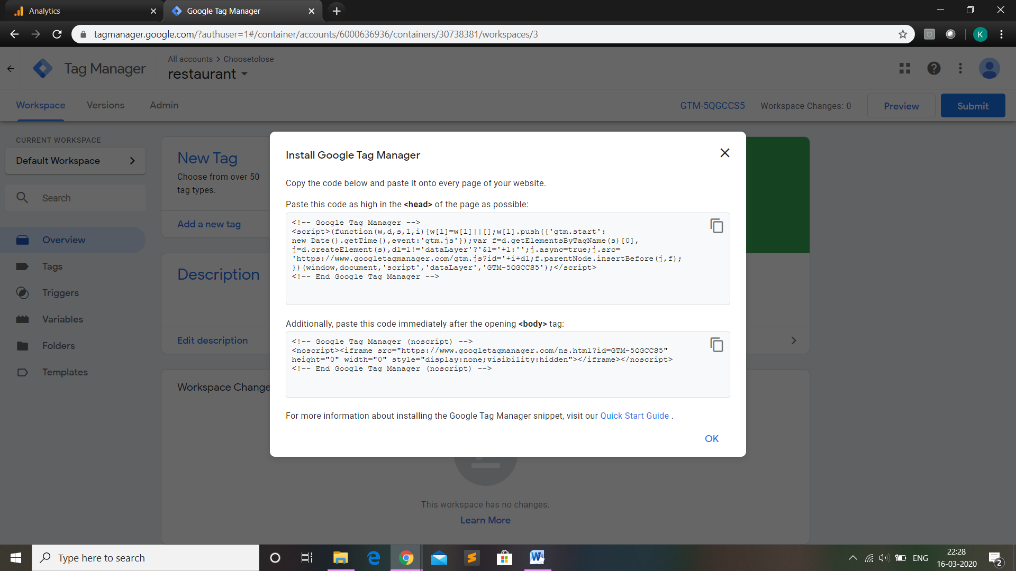
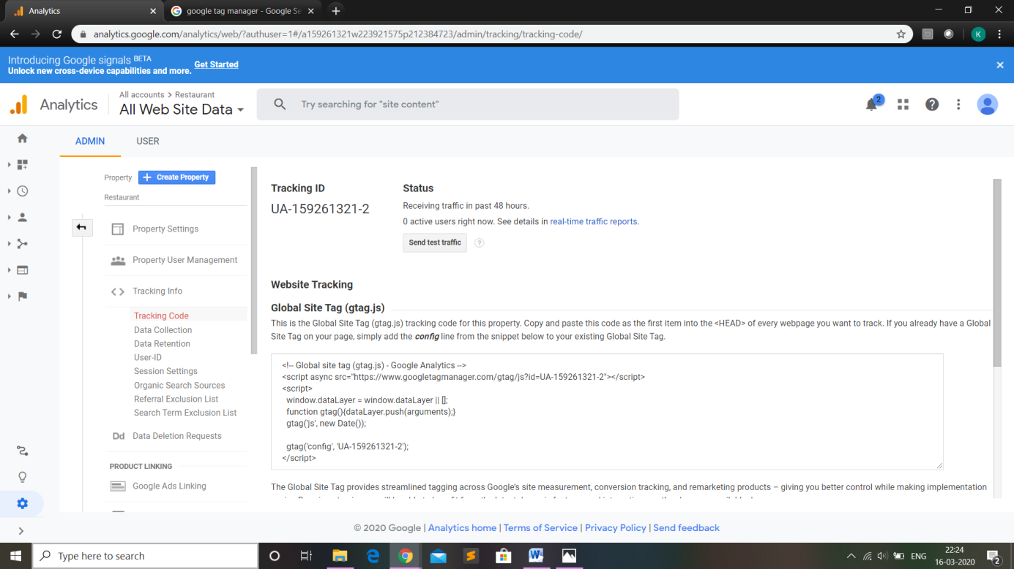

Slide 10
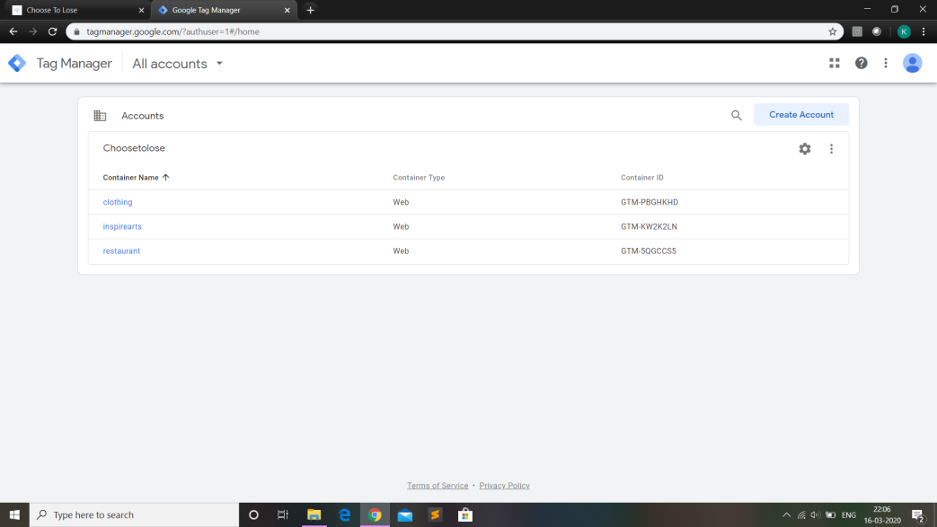
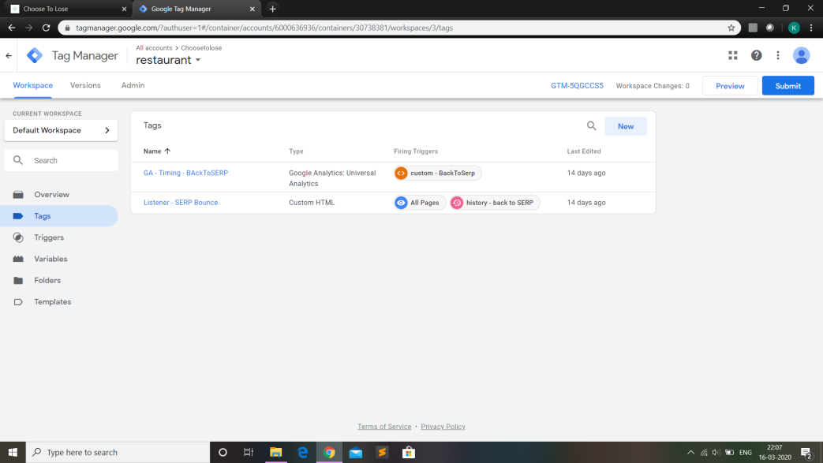
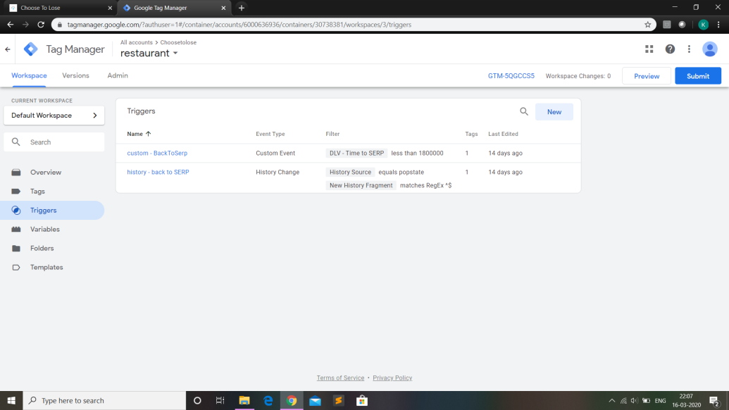
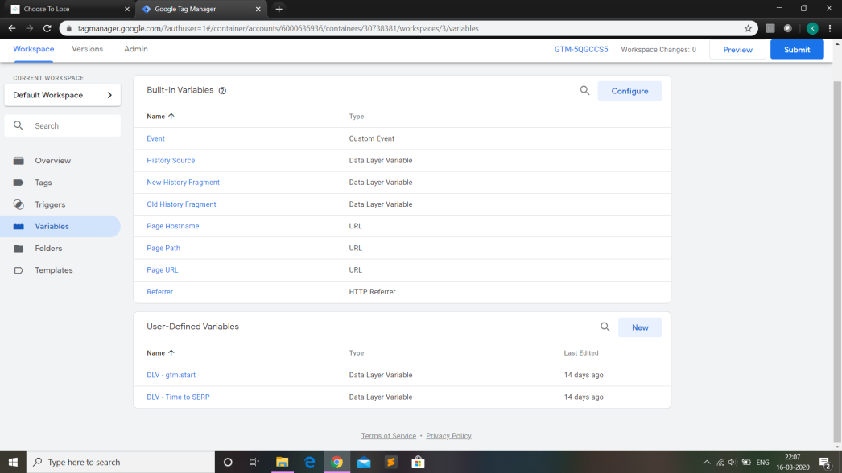

Slide 11
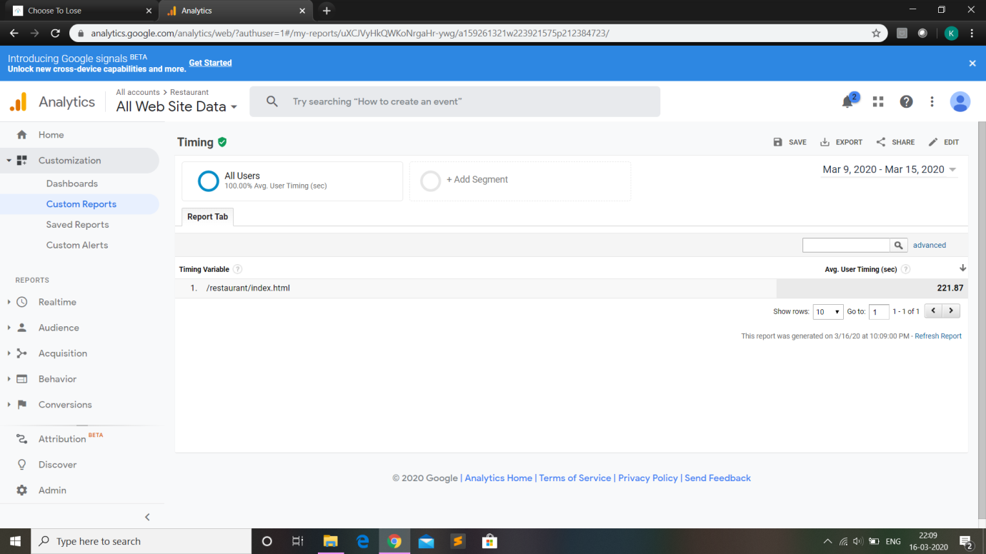
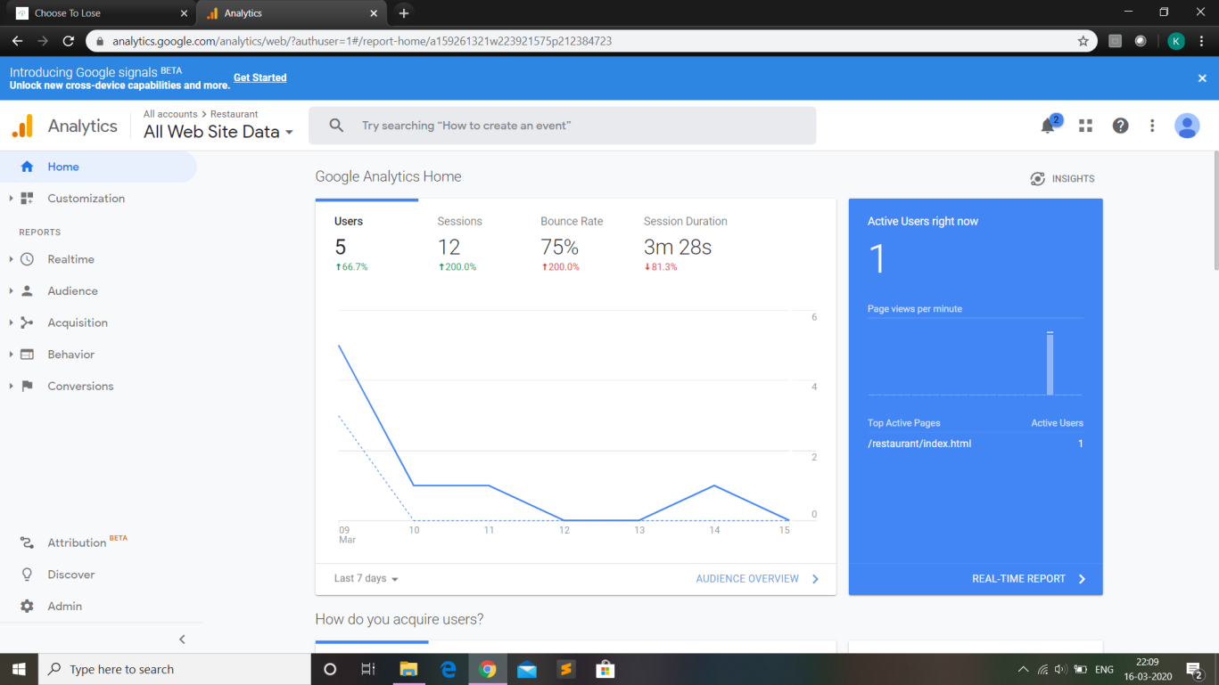

Slide 12
Conclusion
This project has been envisioned for the purpose of predicting whether the click made by a user is genuine or not.
Generally, the client pays the vendor for every click made by the user on an advertisement without having the knowledge of whether the user genuinely made that click or by an accident.
To ensure that the client pays the vendor only for a click that’s genuine, we prepared a model where we track the user’s click and calculate his dwell time and comparing it with the threshold time.
So, if the dwell time of the user on a webpage meets the threshold time or is greater than that, the click is considered to be genuine, if not, then the click is not genuine and the client doesn’t have to pay the vendor for that click.
We have to keep it mind that this model is designed in such a way that we have to make an exception of a case where there might be a possibility of the user to open the webpage and then idle or abandon his computer without closing that webpage.

Slide 13
THANK YOU

